Slide 1
Embracing Change with Extreme Programming
Kent Beck
First Class Software
Notes:
October 1999
Kent Beck owns and operates First Class Software, your typical one-person consulting company masquerading behind a fancy name and answering machine. Two books and 50 articles, and forthcoming Extreme Programming Explained: Embrace Change (Addison Wesley Longman, Reading, Mass., 2000)

Slide 3
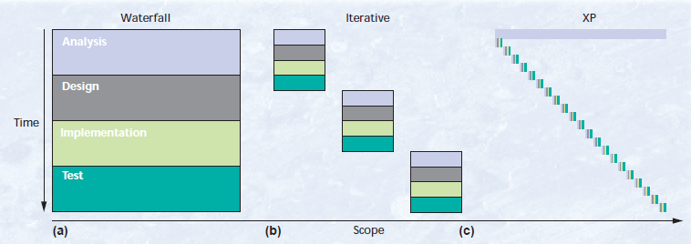
Evolution of XP

Slide 4
History/Roots of XP
Strict split between business and technical decision making: Architect Christopher Alexander – The Timeless Way of Building
Rapid evolution of a plan: Scrum methodology and Ward Cunningham’s Episodes pattern language
Emphasis on specifying and scheduling projects by feature: Ivar Jacobson’s work on use cases
Evolutionary delivery: Tom Gilb’s writings on EVO, getting software into production in weeks and then worry about growth
Initial break from waterfall: Barry Boehm’s Spiral Model
Exploiting powerful technology with JIT method: Dave Thomas and colleagues at Object Technology International
Use of metaphors: George Lakoff and Mark Johnson’s books (Philosophy in the Flesh) and Richard Coyne who links metaphor with software development in a postmodern philosophy
Office space: Jim Coplien, Tom DeMarco, and Jim Lister’s ideas on the importance of physical environment for programmers
Notes:
Evolution

Slide 5
XP Practices (1 of 3)
Planning game
Customers decide on scope and timing of releases based on programmers estimates
Programmers only implement the functionality necessary for the stories in this iteration
Small releases
System is put into production before the whole problem is solved (a few months)
New releases are made often (daily to monthly)
Metaphor
Shape of the system shared between the customer and programmers
Simple design
At any moment:
All tests can/are run
No duplicate code
Fewest possible classes and methods
“Say everything once and only once”

Slide 6
XP Practices (2 of 3)
Tests
Unit tests are written by programmers minute by minute
Customer write functional tests for iteration stories
All tests are run collectively
Must run correctly Refactoring
System design is evolving as existing design is transformed
Keep all tests running (stipulation for practicality)
Pair programming
All production code is written by two people at one workstation (screen/keyboard/mouse)
Continuous Integration
New code is integrated with current system within a few hours
System is built from scratch and all tests must pass
Notes:
Tests: *comparison of shipping a known defect versus delay cost may come into play
CI: if tests do not pass all changes are discarded

Slide 7
XP Practices (3 of 3)
Collective ownership
Every programmer can/does improve any code in the system at any time
On-site customer
Customer sits with the team full-time
40-hour weeks
Isolated overtime use
No working a two weeks of overtime in a row
Open workspace
Large room with small cubicles around the outside
Pair programming computers in the center
Just rules
Following XP means following the rules
Rules change be changed to meet the needs of the team
Notes:
40-hour week:
Too frequent overtime use is a sign of deeper problems and must be addressed
Just rules:
although the importance of following the strict rules is stressed
as long as the team agrees on how they will assess the effect of the change

Slide 8
Anatomy of XP – XP Development Cycle

Slide 9
Anatomy of XP – Stories

Slide 10
Anatomy of XP – Release

Slide 11
Anatomy of XP – Iteration

Slide 12
Anatomy of XP – Task

Slide 13
Anatomy of XP – Test

Slide 14
Common Failures
Underestimation
Uncooperative Customers
Turnover
Changing Requirements

Slide 15
Testaments to XP Success
Acxiom: Working toward a Common Goal (Jim Hannula, Acxiom)
Team: managers, business analysts, developers, testers, and technical writers
Application: Campaign management database
Time: 3 years

Slide 16
Testaments to XP Success
DaimlerChrysler: The Best Team in the World (Chet Hendrickson, DaimlerChrysler)
Team: 10 programmers, 15 total staff
Application: Large-scale payroll system
Time: 4 years

Slide 17
Testaments to XP Success
Ford Motor: A Unique Combination of Agility and Quality (Don Wells, Ford Motor)
Team: 12 programmers, 17 total staff
Application: Cost analysis system
Time: 6 years

Slide 18
Testaments to XP Success
Tariff System: Tests You Can Read (Rob Mee, Independent Consultant)
Team: 3 developers
Application: Shipping tariff calculation system
Time: 3 months

Slide 19
Questions?/Comments

Slide 20
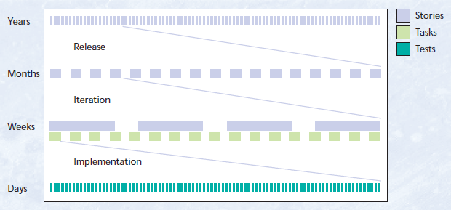
EXTRA

